Slide 1
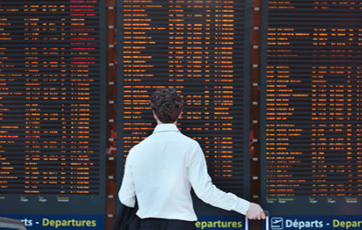
Will my Flight be delayed? Part2
Neel Iyer
April 18, 2017

Slide 2

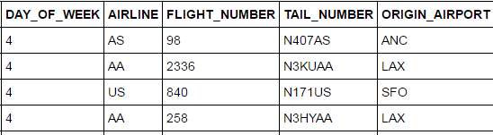
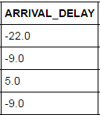
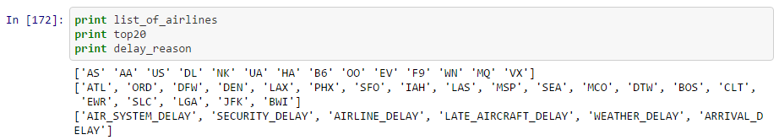
Recap
Final dataset
Acquire the Data
Kaggle Flight Delay is the source of data
All US domestic flights in 2015
A second file with aircraft code and age
A third file with to identify a specific aircraft tail number to seating capacity
X-variables
Top 20 airports
Airlines
Departure Hour
Aircraft size
Day of year
Y-variable
Delay on a score of 1-6 (1 is on-time, 6 is >2 hours)

Slide 3
Model Fit – Continuous Data Not Normalized
 | Logistic Regression | Random Forest Regression
X variables | Hour of Departure (D) Airport (D) Airline (D) Day of year (C) Number of seats (C) | Hour of Departure (D) Airport (D) Airline (D) Day of year (C) Number of seats (C)
y variable | 6 delay outcomes | 6 delay outcomes
Model.score | 0.62 | 0.73
After train and test split(0.40) | 0.62 | 0.54
Cross_val_score (cv=10) | 0.62 | 0.53
Probability of random guess = 1/6 = 0.16
The following variables have been left out to avoid multi-collinearity - HOUR_0, AIRPORT_BWI, AIRLINE_US
D – Dummy
C - Continuous

Slide 4
Model Fit – Continuous Data is Normalized
 | Logistic Regression | Random Forest Regression
X variables | Hour of Departure (D) Airport (D) Airline (D) Day of year (C) Number of seats (C) | Hour of Departure (D) Airport (D) Airline (D) Day of year (C) Number of seats (C)
y variable | 6 delay outcomes | 6 delay outcomes
Model.score | 0.62 | 0.73
After train and test split(0.40) | 0.62 | 0.54
D – Dummy
C - Continuous

Slide 5


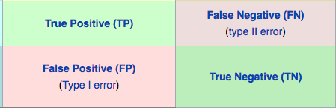
Model Fit – Continuous Data is Normalized & Delay is Binary
0 – delay < 15 mins (Positive)
1 – delay > 15 mins (Negative)
 | Logistic Regression | Random Forest Regression
X variables | Hour of Departure (D) Airport (D) Airline (D) Day of year (C) Number of seats (C) | Hour of Departure (D) Airport (D) Airline (D) Day of year (C) Number of seats (C)
y variable | 0 or 1 | 0 or 1
Model.score | 0.79 | 0.87
After train and test split(0.40) | 0.79 | 0.77
roc_auc_score | 0.5006 | 0.5054
Precision (TP/Predicted P) | 0.79 | 0.79
Recall (TP/Actual P) | 0.99 | 0.99
Removed ‘Day of Year’ – similar result
Notes:
2439996

Slide 6
Conclusions
Hour of day, Origin, Aircraft Size, and Airline do not accurately predict delay (accuracy is slighter higher than guess)
Type 1 error is prevalent – predicts flight to be on time, when it is actually delayed
Random Forest method performs slightly better than Logistic Regression (maybe due to non-linear relationship between input and outcome variables)
Next steps:
Evaluate effect of removing non-weather related delays (system outage, maintenance issue, etc.)
Add Age of Aircraft to X-variable

